Slide 1
NETWORK MODELS

Slide 2
Layered Network Architectures
Two important network architectures.
The OSI reference model
The TCP/IP reference model
OSI model:
Although the protocols associated with the OSI model are not used any more, the model itself is actually quite general and still valid.
The features discussed at each layer are still very important.
TCP/IP model:
It has the opposite properties:
The model itself is not of much use but the protocols are widely used.

Slide 3
The ISO-OSI Reference Model
The Open Systems Interconnection (OSI) model:
Developed by International Standards Organization (ISO) in 1983 and revised in 1995.
First step towards international standardization of the protocols used in the various layers.
It deals with connecting open systems –
ie., systems that are open for communication with other systems regardless of their heterogenous underlying architecture.
The OSI model allows complete interoperability between otherwise incompatible systems.
Notes:
Open System: Model that allows two different systems to communicate regardless of their underlying architecture.
Protocols define format, order of msgs sent and received among network entities, and actions taken on msg transmission, receipt

Slide 4
OSI Layered Architecture
The OSI model is composed of seven layers.
Identified the networking functions with related uses, & collected those functions into discrete groups that became the layers.
Each layer uses the services of the layer immediately below it.
Changes in one layer does not require changes in other layers.
Principles behind the seven layer design:
A layer should be created where a different abstraction (concept) is needed.
Each layer should perform a well-defined function.
The function of each layer should be based on Internationally Standardized Protocols.
The layer boundaries should be chosen to minimize the information flow across the interfaces.
The number of layers should be
large enough that distinct functions need not be put together in same layer.
small enough that the architecture does not become unmanageable.

Slide 6
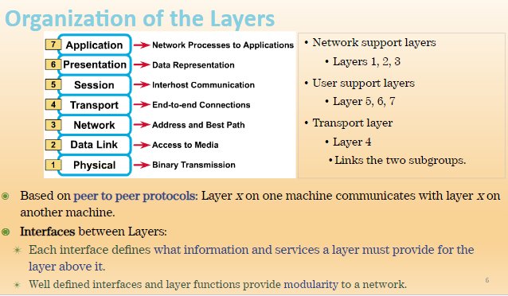

Slide 7
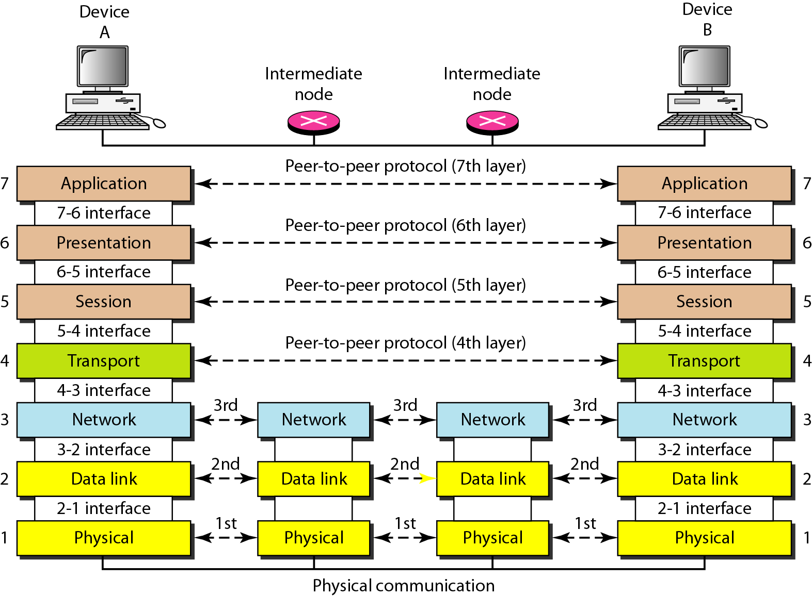
Peer-to-Peer Processes…
The interaction between layers in the OSI Model

Slide 8
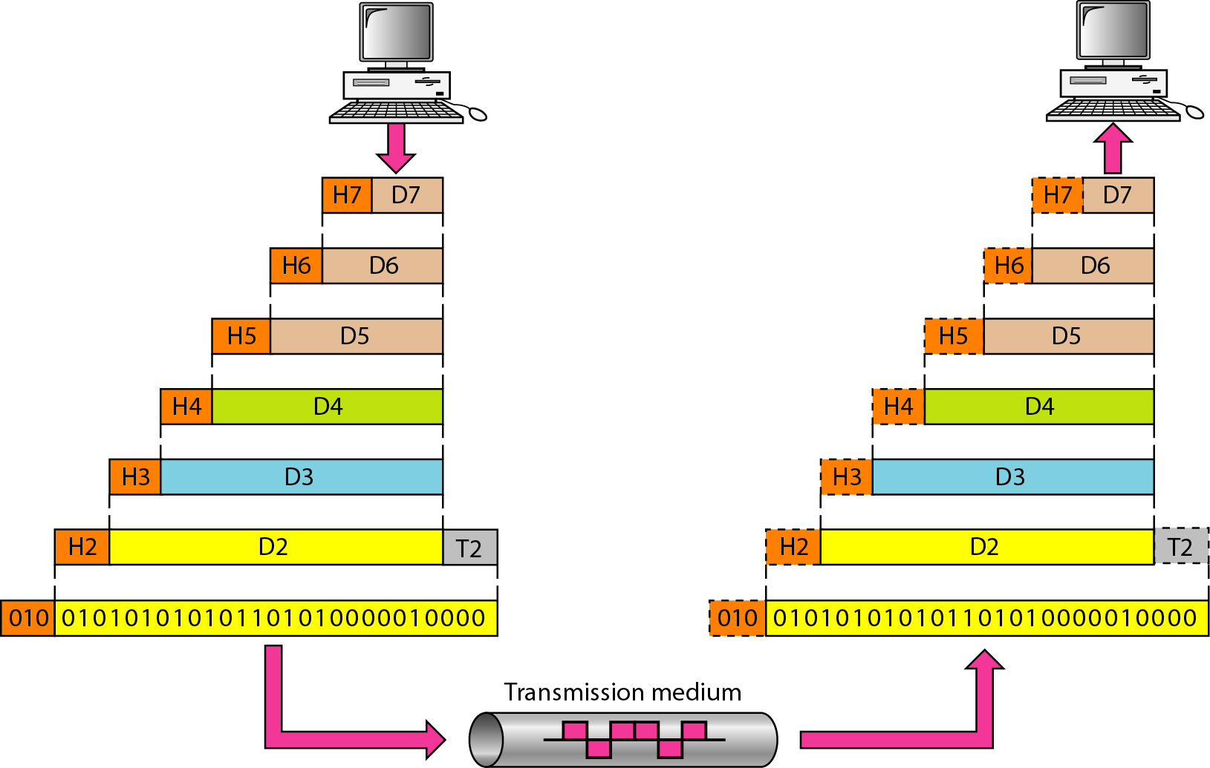
Encapsulation
As the data flows down through the layers, each layer adds some extra information to the data in the form of headers or tailors.
This process of wrapping data with headers and tailors is called Encapsulation. At the receiver side, De-Encapsulation takes place.
The data portion of a packet at level N-1 carries the whole packet from level N.
Notes:
These extra information are added to:
Enable the opposite corresponding layer to take the right operation on the data (to facilitate his work).
Enable the network to transfer the data accurately from the source to the destination.
Through these information each layer actually communicates with the opposite corresponding layer and this is called peer-to-peer communication.
A message begins at the top AL and moves down the OSI layers to the bottom PL.
As the message descends, each successive OSI model layer adds a header to it.
A header is layer-specific information that basically explains what functions the layer carried out.
Conversely, at the receiving end, headers are striped from the message as it travels up the corresponding layers.

Slide 9
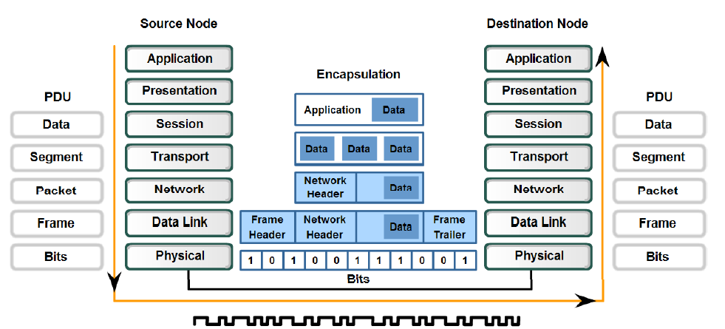
Encapsulation… Data Units at each Layer
Notes:
PDU- Protocol data unit(basic unit of exchange between entities)

Slide 10
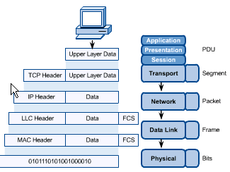
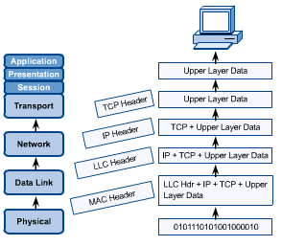
Encapsulation… Data Units at each Layer
Sender
Receiver
Notes:
Fcs-frame check sequence(extra bits added to the frame for error detection)

Slide 11
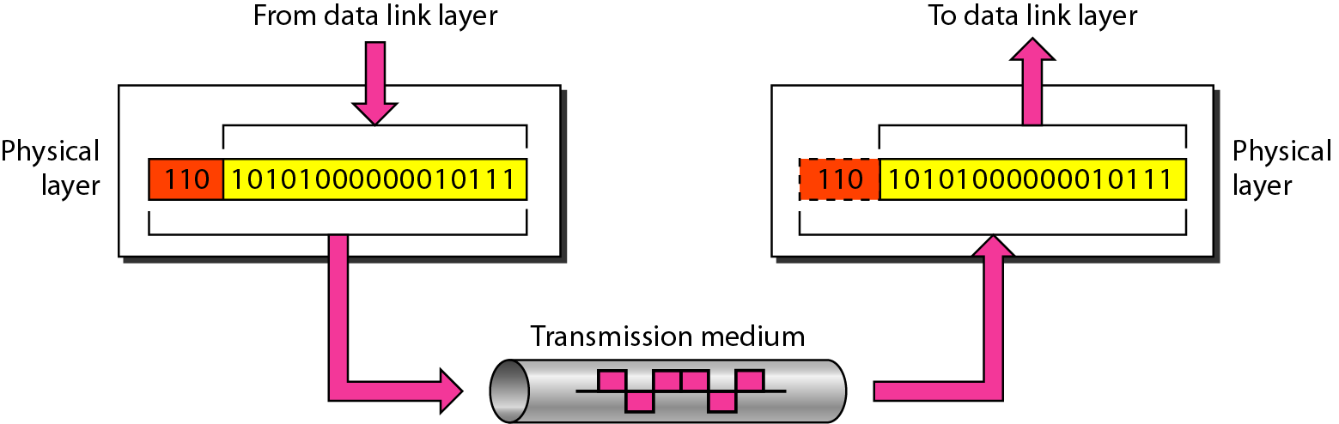
1. Physical Layer
The bottom layer of the OSI model.
Coordinates the functions required to transmit a raw bit stream over a physical medium.
Responsible for movements of individual bits from one hop (node) to the next.

Slide 12
Physical layer functions are the following:
Physical characteristics of interfaces and transmission medium.
Representation of bits - encoding techniques.
Data rate: transmission rate (bps - bits per second).
Synchronization of bits – between sender and receiver clocks.
Line configuration – point to point / multipoint.
Physical topology – star, mesh, ring, bus, hybrid etc.
Transmission mode – simplex/ half duplex/ full duplex.
Converts bits into electronic signals for outgoing messages.
Converts electronic signals into bits for incoming messages.
Repeater is a device of the physical layer.
Physical layer protocols are encoding techniques (RZ, NRZ, Manchester etc).
Notes:
Physical characteristics of interface and media.
Defines the characteristics of the interface between the devices and the transmission media.
It also defines the type of transmission medium.
Representation of bits:
Physical layer receives a steam of bits (sequence of 0s and 1s) without any interruption.
To be transmitted, bits must be encoded into a signals – electrical or optical.
The physical layer defined the type of representation ( how 0s and 1s are changed into signals).
Data rate:
The transmission rate – the number of bit per second- is also defined by the physical layer.
Synchronization of bits. The sender and receiver not only must use the same bit rate but also must be synchronized at the bit level. In other words, the sender and the receiver clocks must be synchronized.
Line configuration. The physical layer is concerned with the connection of devices to the media. In a point-to-point configuration, two devices are connected through a dedicated link. In a multipoint configuration, a link is shared among several devices.
Physical topology. The physical topology defines how devices are connected to make a network. Devices can be connected by using a mesh topology (every device is connected to every other device), a star topology (devices are connected through a central device), a ring topology (each device is connected to the next, forming a ring), a bus topology (every device is on a common link), or a hybrid topology (this is a combination of two or more topologies).
Transmission mode. The physical layer also defines the direction of transmission between two devices: simplex, half-duplex, or full-duplex. In simplex mode, only one device can send; the other can only receive. The simplex mode is a one-way communication. In the half-duplex mode, two devices can send and receive, but not at the same time. In a full-duplex (or simply duplex) mode, two devices can send and receive at the same time.

Slide 13
Design issues are
to make sure that when one side sends a 1 bit, it is received by the other side as a 1 bit, not as a 0 bit,
what electrical signals used to represent a 1 and a 0,
how many nanoseconds a bit lasts,
whether transmission may proceed simultaneously in both directions,
how the initial connection is established,
how it is torn down when both sides are finished,
how many pins the network connector has, what each pin is used for.
These design issues deal with
mechanical, electrical, & timing interfaces,
the physical transmission medium, which lies below the physical layer,
and interfaces like cable, connector etc.

Slide 14
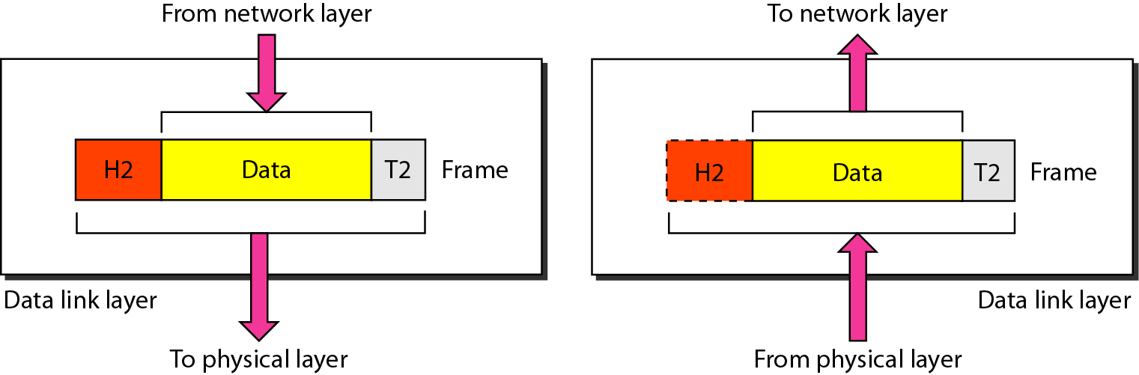
2. Data Link Layer
Responsible for moving frames from one hop (node) to the next.
The PDU of the data link layer is called frame.
DLL handles data frames between the NL and the PL.
At the sending end, DLL handles conversion of data into raw formats that can be handled by the PL.
At the receiving end, this layer packages raw data from the PL into data frames for delivery to the NL.

Slide 15
Data link layer is divided into 2 sublayers.
Logical Link Control (LLC) sub layer
Medium Access Control (MAC) sub layer
The major duties of the data link layer are:
Framing – creating and managing frames.
Physical addressing: frame header contains this address.
MAC address, which is hard coded into Network Interface Card (NIC) and is of 48-bit represented by Hexadecimal format.
Flow control – prevents overwhelming the receiver.
Error control – detect and retransmit damaged frames (trailer).
Access control – how to access link amongst multiple devices.
Data Link layer protocols are sliding window protocol, CRC, hamming code, CSMA, CSMA/CD, CSMA/CA, Token Passing etc.
Notes:
Framing:
The data link layer divides the stream of bits steam from the network layer into manageable data units called frames.
Physical addressing:
If frame is to be distributed to different systems on the network, the data link layer adds a header to the frame to define the sender and receiver of the frame.
Physical address is the MAC address, which is hard coded into NIC and is of 48-bit represented by Hexadecimal format.
MAC Addresses are unique 48-bit hardware number of a computer, that is embedded into a network card (known as a Network Interface Card during manufacturing.
Flow control:
If the rate at which the data are absorbed by the receiver is less than the rate produced in the sender, the data link layer imposes a flow control mechanism to prevent overwhelming the receiver.
Error control:
The data link layer adds reliability to the physical layer by adding mechanism to detect and retransmit damaged or lost frames.
It also uses a mechanism to prevent duplication of frames.
Error control is normally achieved through a trailer added to the end of the frame.
Access control:
The data link layer protocol has to determine that how to get access to the link in case when two or more devices are connected to the same link.

Slide 16
Main task: Error Control
to transform a raw transmission facility into a line that appears free of undetected transmission errors to the network layer.
sender break up the input data into data frames (typically a few hundred or a few thousand bytes) and transmit the frames sequentially.
If the service is reliable, the receiver confirms correct receipt of each frame by sending back an acknowledgement frame.
Another Issue: Flow control
how to keep a fast transmitter from drowning a slow receiver in data.
traffic regulation mechanism is often needed to let the transmitter know how much buffer space the receiver has.
Additional issue in broadcast networks:
how to control access to the shared channel.
MAC sublayer handles the access control in broadcast networks.

Slide 17
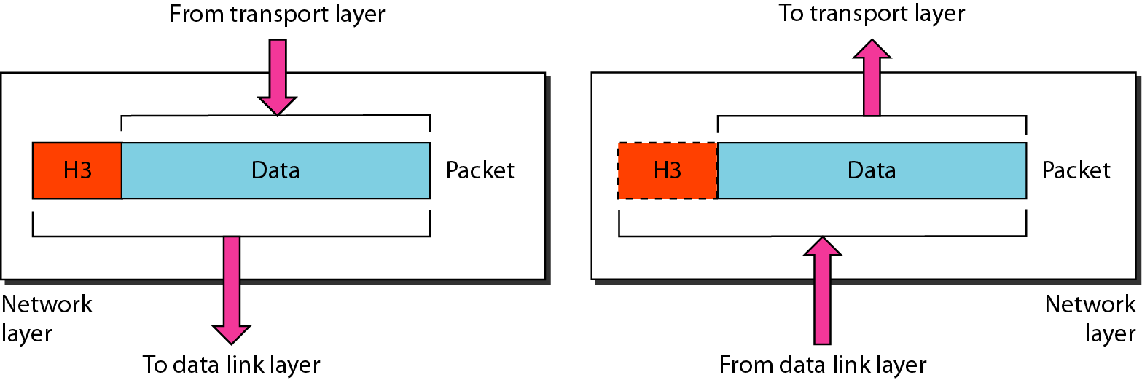
3. Network Layer
Responsible for the delivery of individual packets from the source host to the destination host.
Functions: Logical (IP) addressing & Routing
Logical address / IP address - 32-bits represented in dotted decimal format.
The PDU of network layer is a packet.
Notes:
Logical addressing:
The physical addressing implemented by the data link layer handles the addressing problem locally.
If a packet passes the network boundary, we need another addressing system to perform the source and destination delivery.
The network layer adds a header to the segment received from the session containing the logical addresses of the sender and receiver.
Logical address is also called IP address which is of 32-bits and represented in decimal format.
Routing:
To route the packets from the source to destination in an internetwork, the router uses network layer information.

Slide 18
Handles addressing messages for delivery, as well as translates logical/IP addresses into corresponding physical/MAC addresses.
Responsible for deciding how to route transmissions between computers, for the delivery of a packet possibly across multiple networks.
It two systems are connected to the same link/network, there is usually no need for a network layer.
However, if the two systems are attached to different networks with connecting devices like routers between the networks, NL is needed to accomplish the delivery.
Also handles packet switching and network congestion control.
Network layer protocols are IP, IPX, AppleTalk.
Notes:
When a packet has to travel from one network to another to get to its destination, many problems can arise. The addressing used by the second network may
be different from that used by the first one. The second one may not accept the
packet at all because it is too large. The protocols may differ, and so on. It is up
to the network layer to overcome all these problems to allow heterogeneous networks
to be interconnected.
In broadcast networks, the routing problem is simple, so the network layer is
often thin or even nonexistent.

Slide 19
The network layer controls the operation of the subnet.
A key design issue: determining how packets are routed from source to destination.
based on static tables that are ‘‘wired into’’ and rarely changed, or
dynamic tables that are updated automatically to avoid failed components, considering the current network load.
Handle congestions, if too many packets are present in the subnet at the same time.
The quality of service (QoS) provided (delay, transit time, jitter, etc.) is also a network layer issue.
Notes:
Static Routing is also known as non-adaptive routing which doesn’t change the routing table unless the network administrator changes or modifies them manually. Static routing does not use complex routing algorithms and It provides high or more security than dynamic routing. Dynamic routing is also known as adaptive routing which changes the routing table according to the change in topology. Dynamic routing uses complex routing algorithms and it does not provide high security like static routing
Latency is the total time required by a packet in transmission from the source IP address to the destination. Jitter in internet protocol networks means a variation in latency of a data packet

Slide 20
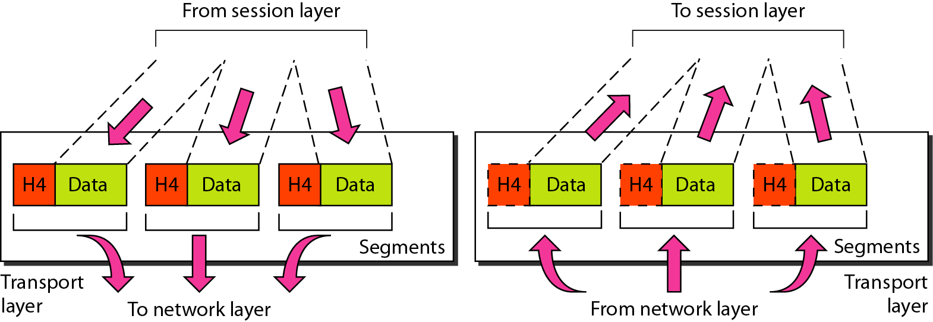
4. Transport Layer
Responsible for the delivery of segments from source process to destination process.
Takes care of end to end delivery of the entire message.
Manages the flow by segmenting long data streams into smaller data chunks called “segment”.
Reassembles chunks into their original sequence at the receiving end.
Provides acknowledgements of successful transmissions and requests resends for packets which arrive with errors.

Slide 21
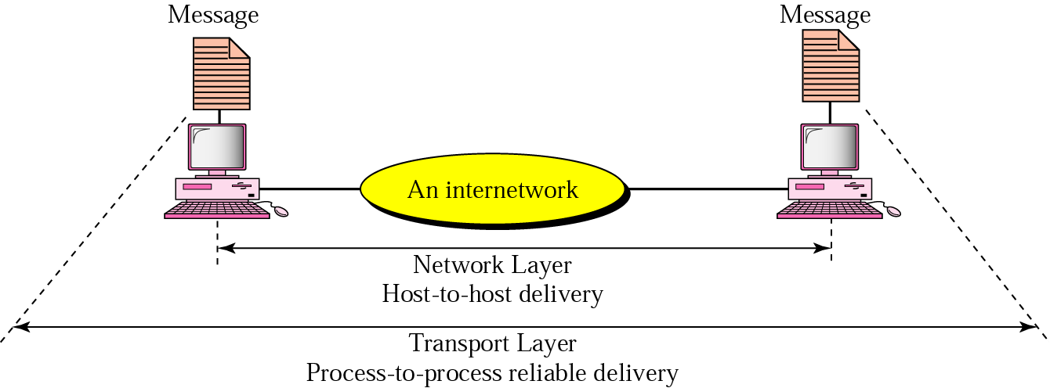
TL is a true end-to-end layer, from the source to the destination.
ie, a program on the source machine carries on a conversation with a similar program on the destination machine,
using the message headers and control messages.
But, in the lower layers, the protocols are between each machine and its immediate neighbors (routers), and not between the ultimate source and destination machines.
Notes:
(As an aside, an error-free channel is completely impossible to achieve; what people really mean by this term is that the error rate is low enough to ignore in practice.)

Slide 22
Basic function:
To accept data from the upper layer, split it up into smaller units if needed,
pass these to the network layer, and ensure that the pieces all arrive correctly at the other end.
All this must be done efficiently and in a way that isolates the upper layers from the inevitable changes in the hardware.
Also determines what type of service (ToS) to provide
The most popular type is an error free point-to-point channel that delivers messages or bytes in the order in which they were sent.
Other kind of service is the transporting of isolated messages with no guarantee about the order of delivery, and the broadcasting of messages to multiple destinations.
The ToS is determined when the connection is established.
Notes:
(As an aside, an error-free channel is completely impossible to achieve; what people really mean by this term is that the error rate is low enough to ignore in practice.)

Slide 23
The major duties performed by the transport layer are:
Service Port addressing (socket address)
IP + port no. (identifies machine and the communicating process in it)
NL gets each packet to the correct computer, the transport layer get the entire message to the correct process on that computer.
Segmentation and reassembly – segments with sequence no. for reassembly
Connection Control - connectionless or connection oriented
Flow control - end to end
Error control - end to end
Transport layer protocols include TCP (Transmission Control Protocol) and UDP (User Datagram Protocol).
Notes:
The transport layer is responsible for process-to-process delivery of the entire message.
The major duties performed by the transport layer are:
Service Port addressing:
Computers often running several processes (running programs) at the same time:
Each running process open a logical port on the computer.
The transport layer header must therefore include a type of address called port address.
The network layer gets each packet to the correct computer, the transport layer get the entire message to the correct process on that computer.
Segmentation and reassembly:
A message received form the upper layers is divided into transmittable segments, each segment contains a sequence number.
These number enables the transport layer to reassemble the message correctly upon arrival at the destination and to identify and replace packets that were lost in the transmission.
Connection Control:
The transport layer can be either connectionless or connection oriented.
A connection oriented transport layer makes a logical connection with the transport layer at the destination machine first before delivering the packets.
After all the data are transferred, the connection is terminated.
Flow control:
Like data link layer, the transport layer is responsible for flow control.
However, flow control at this layer is performed end to end rather than across a single link.
Error control:
Like data link layer, the transport layer is responsible for error control.
However, error control at this layer is performed end to end rather than across a single link.
Transport layer 4 protocols include TCP (Transmission Control Protocol) and UDP (User Datagram Protocol).

Slide 24
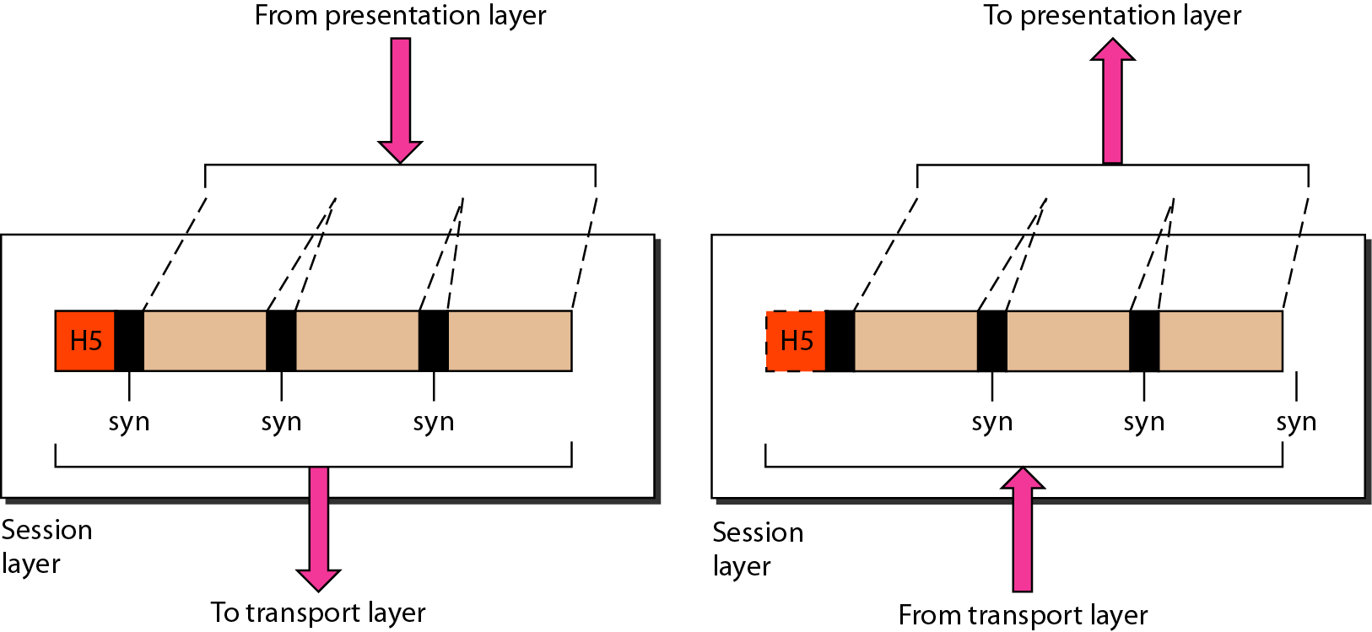
5. Session Layer
Responsible for dialog control and synchronization.
Initiating, maintaining and terminating sessions
Security and access control to session information (via session participant identification)
Session layer protocols are SQL, ASP (AppleTalk Session Protocol), Remote Procedure Call (RPC), X Window System.

Slide 25
The session layer allows users on different machines to establish sessions between them.
Defines how to establish, maintaining and terminates session between two communication hosts.
Applications on either end of the session are able to exchange data for the duration of the session
Sessions offer various services, including
dialog control (keeping track of whose turn it is to transmit),
token management (preventing two parties from attempting the same critical operation simultaneously), and
synchronization (checkpointing long transmissions to allow them to pick up from where they left off in the event of a crash and subsequent recovery).
Notes:
Enables two networked resources to hold ongoing communications (called a session) across a network
The major duties of the session layer are:
Synchronization:
For lengthy transaction (file transfer), the user may choose to establish synchronization points associated with the transfer. If a fault develops during a transaction, the dialog may be restarted at an agreed synchronization point.
Dialog control:
Session layer determines that which role is to be played at any given time by a host.
Duplex: Two-way simultaneous.
Half-Duplex: Two-way alternate.
Simplex: One-way.

Slide 26
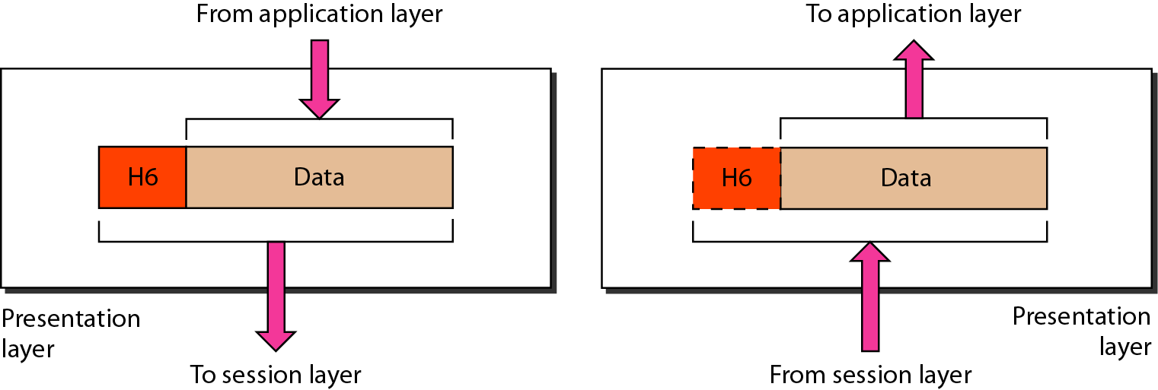
6. Presentation Layer
Unlike the lower layers, which are mostly concerned with moving bits around, the presentation layer is concerned with the syntax and semantics of the information transmitted.
Responsible for translation (format conversion), compression, and encryption.

Slide 27
In order to make it possible for computers with different internal data representations to communicate,
the data structures to be exchanged can be defined in an abstract way,
along with a standard encoding to be used ‘‘on the wire.’’
This layer manages these abstract data structures and allows higher-level data structures (eg., banking records) to be defined and exchanged.
The presentation layer ensures that the information that the application layer of one system sends out is readable by the application layer of another system.
Protocols of the presentation layer are JPEG, MPEG, ASCII, EBCDIC etc.
Notes:
The major duties of the presentation layer are:
Format conversion:
Convert message from one format into another format .i.e. for ASCII to EBCEDIC or vice versa.
Compression.
Compress the message to take less bandwidth on the transmission media and less time for transmission.
Encryption:
Convert the message into a form that will not be readable by others.
Provides security to the message.
Manages data-format information for networked communications (the network’s translator)
For outgoing messages, it converts data into a generic format for network transmission; for incoming messages, it converts data from the generic network format to a format that the receiving application can understand
This layer is also responsible for certain protocol conversions, data encryption/decryption, or data compression/decompression
A special software facility called a “redirector” operates at this layer to determine if a request is network related on not and forward network-related requests to an appropriate network resource

Slide 28
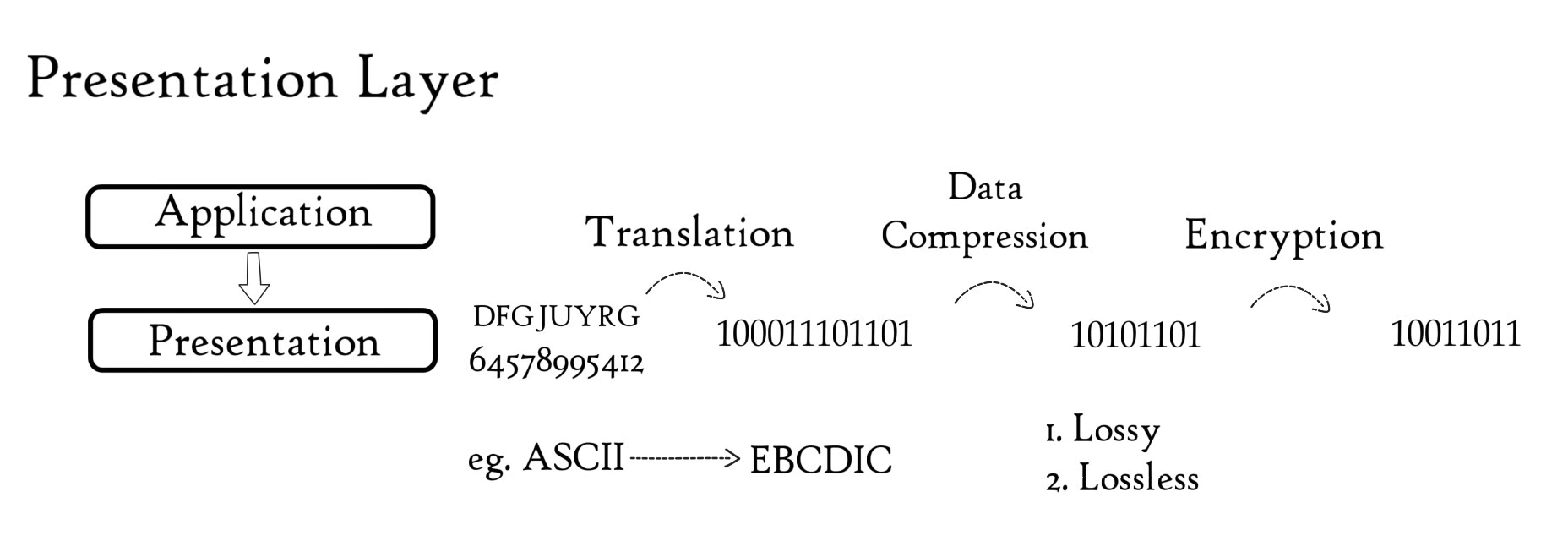
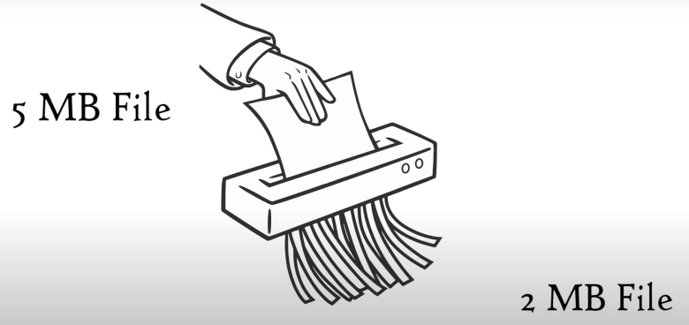

Slide 29
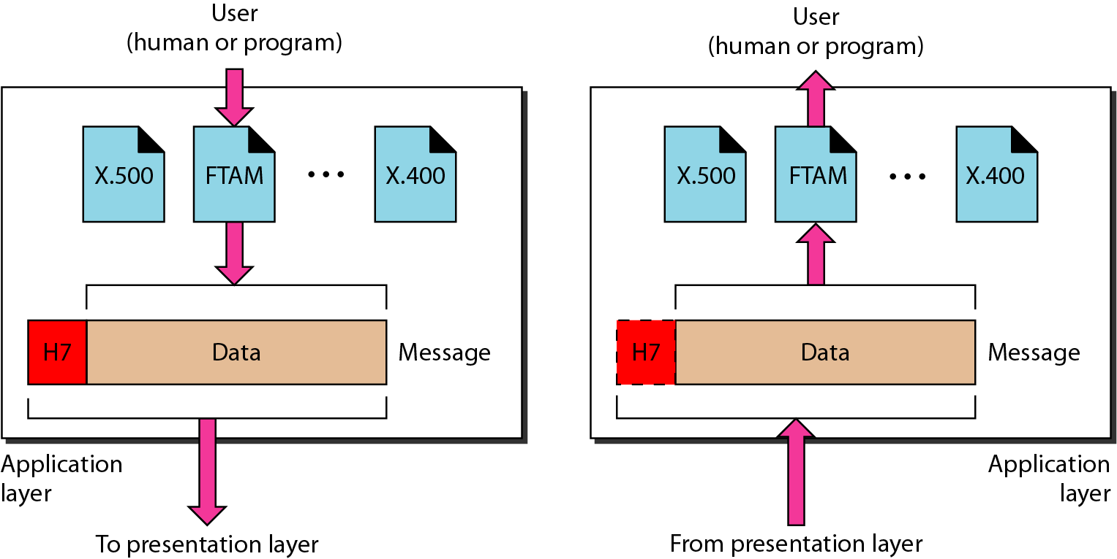
7. Application Layer
Responsible for providing services to the user.
The layer that is closest to the user; provides network services to the user’s applications.

Slide 30
The application layer contains a variety of protocols that are commonly needed by users.
Eg. HTTP (HyperText Transfer Protocol), which is the basis for the World Wide Web.
When a browser wants a Web page, it sends the name of the page it wants to the server hosting the page using HTTP. The server then sends the page back.
Other application protocols are used for
file transfer,
remote access,
electronic mail, and
network news.
Notes:
Provides a set of interfaces for sending and receiving applications to gain access to and use network services, such as: networked file transfer, message handling and database query processing
The major duties are:
Mail service:
It provides network services for the email application.
File transfer and Access:
It provides network services for a user to access files on a remote computer, to retrieve files from a remote computer for use in the local computer and to manage or control files in a remote computer locally.
World Wide Web:
It provides network services to access the World Wide Web.

Slide 31
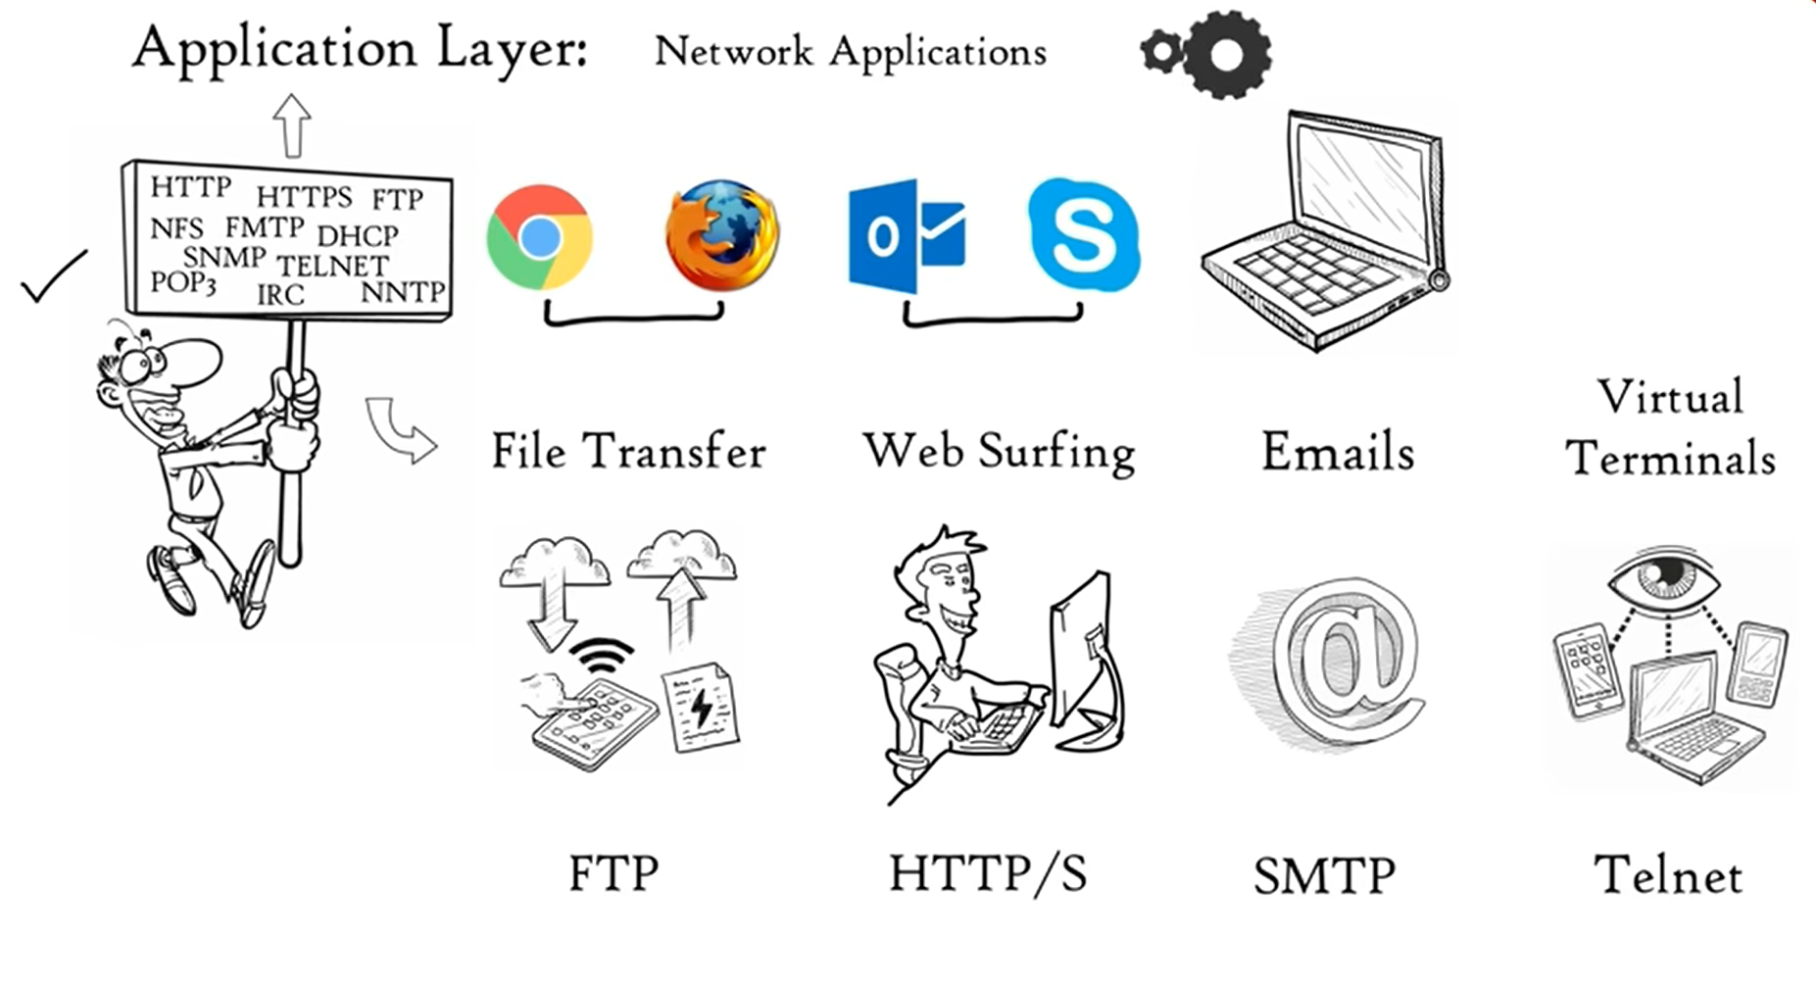

Slide 32
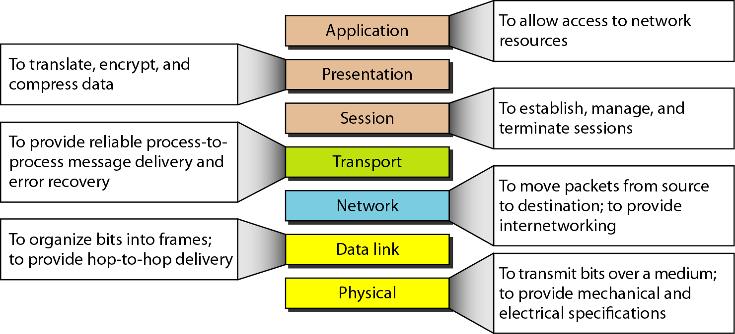
OSI Model - Summary

Slide 33
TCP/IP Model
TCP/IP Protocol Architecture

Slide 34
TCP/IP Protocol Architecture
Developed by the US DoD’s Defense Advanced Research Project Agency (DARPA) for its packet switched network ARPANET. (the predecessor to the Internet)
TCP/IP was developed in the 1970s and adopted as the protocol standard for ARPANET in 1983.
First described by Cerf and Kahn, later refined and defined as a standard in the Internet community.
Used by the global Internet. (No official model but a working one.)
The ability to connect multiple networks in a seamless way was one of the major design goals.
This architecture later became known as the TCP/IP Reference Model, after its two primary protocols.
Notes:
Connected hundreds of Universities and Government installations, using leased telephone lines
When satellite and radio networks were added later, the existing protocols had trouble interworking with them
So, a new reference architecture was needed

Slide 35
TCP/IP Protocol Architecture…
Another major goal
network must be able to survive loss of subnet hardware, with existing conversations not being broken off.
ie, DoD wanted connections to remain intact as long as the source and destination machines were functioning
even if some of the machines or transmission lines in between were suddenly put out of operation.
Also, a flexible architecture was needed
since applications with divergent requirements were envisioned, ranging from transferring files to real-time speech transmission
Notes:
Connected hundreds of Universities and Government installations, using leased telephone lines
When satellite and radio networks were added later, the existing protocols had trouble interworking with them
So, a new reference architecture was needed

Slide 36
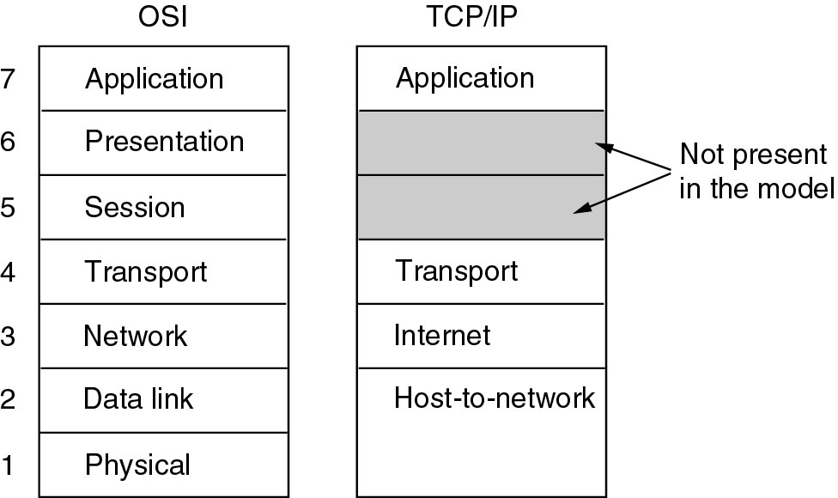
TCP/IP vs OSI

Slide 37
Host-to-Network Layer
Host has to connect to the network using some protocol so that it can send IP packets to it.
Protocol is not defined and varies from host to host and network to network – it is an interface between hosts and transmission links.
The model does not really say much about what happens here
Internet Layer
All requirements of DoD led to the choice of a packet-switching n/w based on a connectionless internetwork layer.
This layer is called so, because it is the key player that holds the whole architecture together.
It permit hosts to inject packets into any network and have them travel independently to the destination on a different network
They may arrive in a different order than they were sent, higher layers may rearrange them, if in-order delivery is desired.
Notes:
describes what links such as serial lines and classic Ethernet must do to meet the needs of this connectionless internet layer.
Note that ''internet'' is used here in a generic sense, even though this layer is present in the Internet.

Slide 38
TCP/IP Protocol Architecture…
Internet Layer…
Internet layer defines an official packet format and protocol called IP (Internet Protocol)
plus a companion protocol called ICMP (Internet Control Message Protocol) that helps it function.
The job of the internet layer is to deliver IP packets where they are supposed to go.
Packet routing and avoiding congestion are the major issues here.
For these reasons, it is reasonable to say that the TCP/IP internet layer is similar in functionality to the OSI network layer.
Notes:
describes what links such as serial lines and classic Ethernet must do to meet the needs of this connectionless internet layer.
Note that ''internet'' is used here in a generic sense, even though this layer is present in the Internet.

Slide 39
TCP/IP Protocol Architecture…
Transport Layer
designed to allow peer entities on the source and destination hosts to carry on a conversation. (as in OSI Transport layer)
Two end-to-end transport protocols
TCP (Transmission Control Protocol)
UDP (User Datagram Protocol)
UDP - Unreliable connectionless protocol.
For applications that do not want TCP's sequencing or flow control and wish to provide their own.
Also widely used for one-shot, client-server-type request-reply queries and
applications in which prompt delivery is more important than accurate delivery, such as transmitting speech or video.

Slide 40
TCP/IP Protocol Architecture…
TCP
Reliable connection-oriented protocol.
Allows a byte stream on one machine to be delivered without error on any other machine in the internet.
It fragments the incoming byte stream into discrete messages and passes each one on to the internet layer.
At the destination, the receiving TCP process reassembles the received messages into the output stream.
TCP also handles flow control to make sure a fast sender cannot swamp a slow receiver with more messages than it can handle.

Slide 41
TCP/IP Protocol Architecture…
Protocols and networks in the TCP/IP model initially.

Slide 42
Comparison of the OSI and TCP/IP Models
Similarities:
The OSI and TCP/IP reference models have much in common.
Both are based on the concept of a stack of independent protocols.
Also, the functionality of the layers is roughly similar.
Eg., in both models the layers up through and including the transport layer are there to provide an end-to-end, network-independent transport service to processes wishing to communicate. These layers form the transport provider.
Again in both models, the layers above transport are application-oriented users of the transport service.

Slide 43
Comparison of the OSI and TCP/IP Models…
Differences:
There are three important concepts for OSI model
1. Services 2. Interfaces 3.Protocols
Each layer performs some services for the layer above it.
It tells what the layer does. It defines the layer’s semantics. (not how entities above it access it or how the layer works.)
A layer's interface tells the processes above it, how to access it.
It specifies what the parameters are and what results to except.
The peer protocols used in a layer are the layer's own business.
It can use any protocols it wants to.
It can also change them without affecting software in higher layers.
OSI model makes the distinction between these three concepts explicit where as the TCP/IP model doesn’t.

Slide 44
Comparison of the OSI and TCP/IP Models…
The OSI reference model was devised before the corresponding protocols were invented. So, the model was not biased toward one particular set of protocols; it is quite general.
With TCP/IP, the protocols came first, and the model was a description of the existing protocols.
The model did not fit any other protocol stacks. Consequently, it was not especially useful for describing other, non-TCP/IP networks.
The protocols in the OSI model are better hidden than in the TCP/IP model and can be replaced relatively easily as the technology changes.

Slide 45
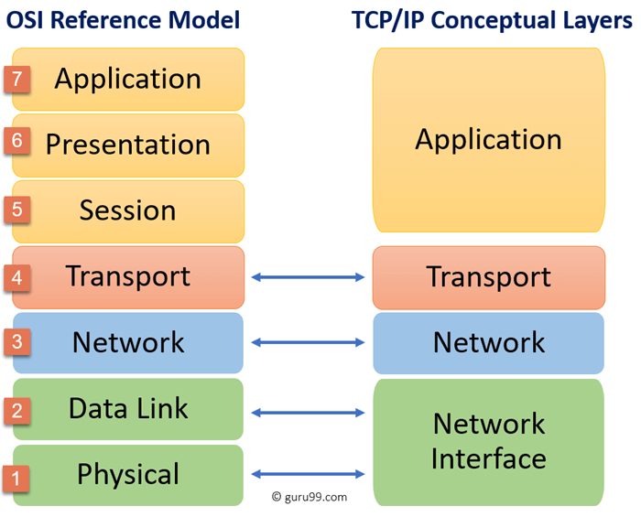
Comparison of the OSI and TCP/IP Models…
The OSI model has seven layers and TCP/IP has four layers.
Both have (inter)network, transport and application layers, but the other layers are different.
The OSI model supports both connectionless and connection-oriented communication in the network layer, but only connection-oriented communication in the transport layer.
The TCP/IP model has only connectionless mode in the network layer but supports both modes in the transport layer.

